Slide 1


Slide 2

Thanks to our partners

Slide 3

Kim Jest-On
Sharepoint Specialist @
Interests:
IoT
Data Science
Books
Travels
Physical activity
Contact:
Mail: Michal.guzowski@findwise.com
Blog: ITGoat.pl
Twitter: @michaelguzowski
Facebook: Michał Guzowski
LinkedIn: Michał Guzowski

Slide 4

Case study
Biggest heat and electricity producer in Poland
Employs over 1000 people
Change: New knowledge management policy

Slide 5
Case study
Poor knowledge accessibility
Time duplication (22%)
Time loss (33%)
Low reliability of conclusions (22%)
Limited information flow (25%)

Slide 6
Case study
Poor knowledge accessibility
Search solution
Time duplication (22%)
Time loss (33%)
Low reliability of conclusions (22%)
Limited information flow (25%)
SP 2013 Search
Custom BCS connector (m.in. ERP)
Search Config (Result Sources, Query Rules, KQL)
Increased productivity
Reduced number of decision made under insufficient information conditions

Slide 7
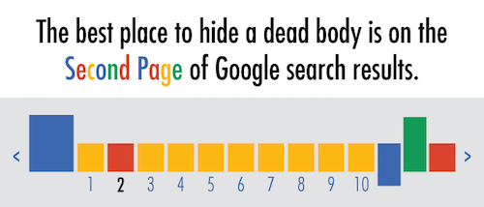
First page results

Slide 8
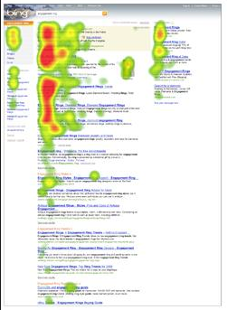
Top 5 results

Slide 9
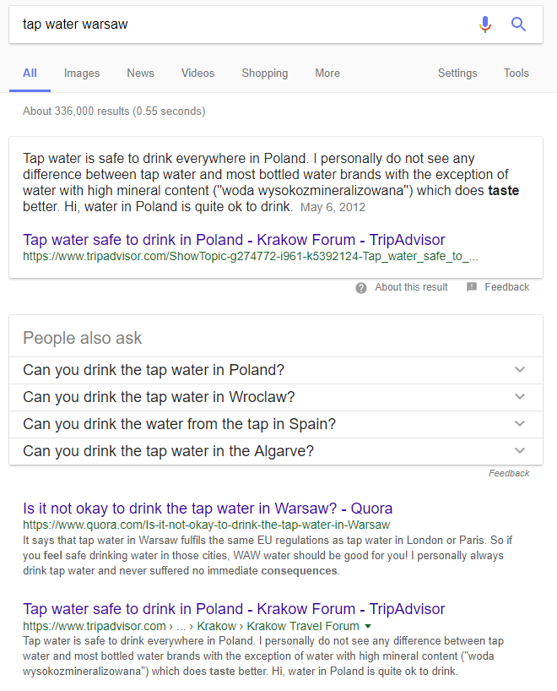

Answers > results

Slide 10
Conclusion
Answers

Slide 11
Conclusion
Answers
Accurate results

Slide 12
Conclusion
Search Driven Content
Search Results

Slide 13
Conclusion
Search Driven Content
Search Results
Search Engine Configuration

Slide 14
Conclusion
Search Driven Content
Search Results
Search Engine Configuration
Information Architecture

Slide 15
Search Driven Architecture
Search Driven Content
Search Results
Search Engine Configuration
Information Architecture

Slide 16
Search Driven Architecture
View
Search Driven Content
Controller
Search Results
Model
Search Engine Configuration
Information Architecture

Slide 17
Search Driven Architecture
View
Search Driven Content
SPFx + React
Controller
Search Results
Ranking
Model
Search Engine Configuration
Search Schema
Information Architecture

Slide 18
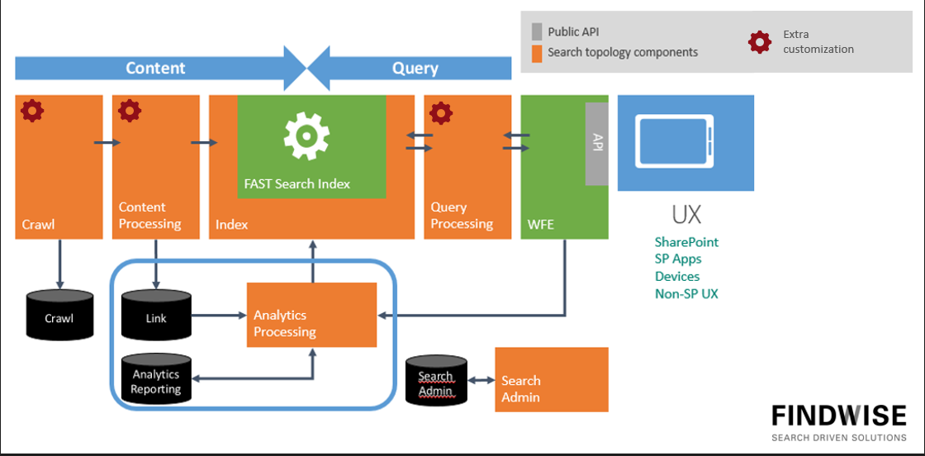
Search Engine Configuration
- Sharepoint
- SPFx/SP Apps

Slide 19
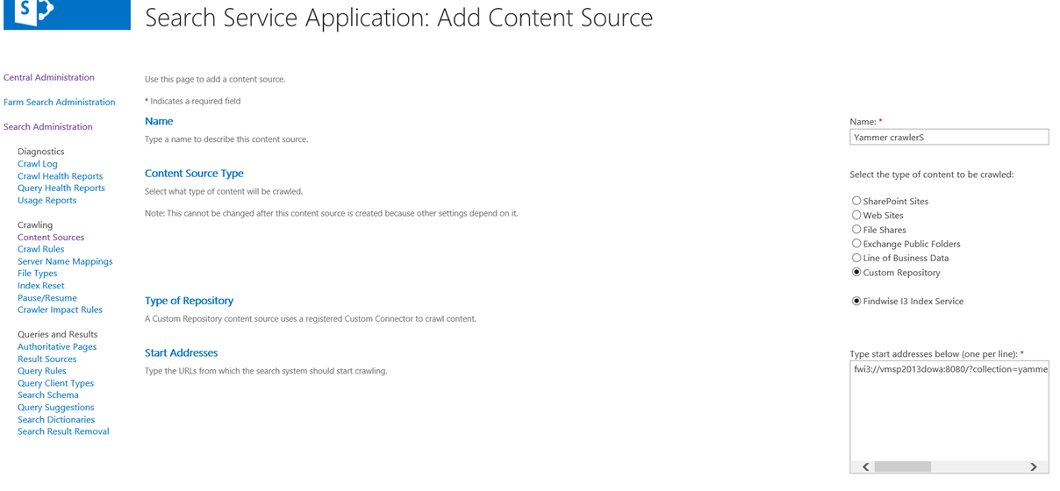
Search Engine Configuration

Slide 20
Search Engine Configuration
- Sharepoint
- SPFx/SP Apps

Slide 21
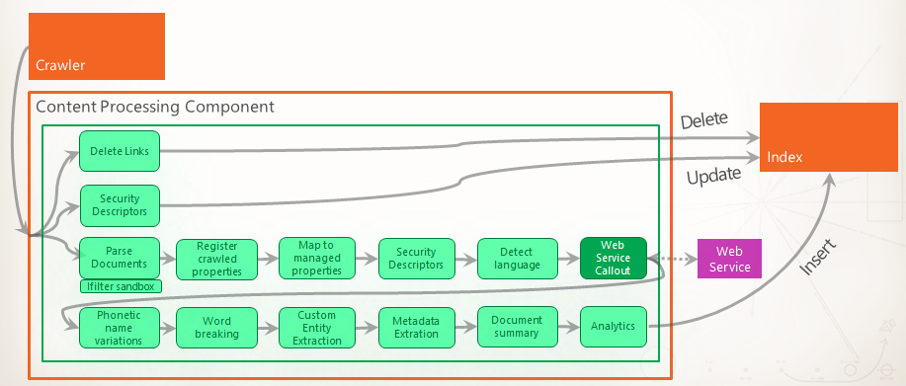
Search Engine Configuration

Slide 22
Search Engine Configuration

Slide 23
Search Engine Configuration
- Sharepoint
- SPFx/SP Apps

Slide 24
Search Engine Configuration
Query
Ranking model
Final query

Slide 25
Search Engine Configuration
Query
KQL
Search schema
Result Sources
Query rules
Custom ranking model
Ranking model
Final query

Slide 26
Search Engine Configuration
User input
Plain text
Query
KQL
Search schema
Result Sources
Query rules
Custom ranking model
Ranking model
Final Results

Slide 27
Search Engine Configuration
- Sharepoint
- SPFx/SP Apps

Slide 28
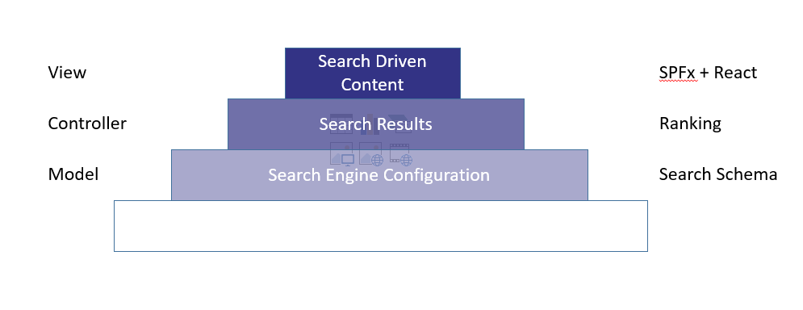
Search Engine Configuration
- Sharepoint
- SPFx/SP Apps

Slide 29
Search Engine Configuration
Model
Controller
View
- Sharepoint
- SPFx/SP Apps

Slide 30
DEMO

Slide 31
Search schema
KQL
*
Created: this year
XRANK!
Result Sources
Narrowing
Query rules
Custom ranking model
Notes:
{searchboxquery} XRANK(cb=0.90 stdb=0.90) (Title:{searchboxquery})

Slide 32
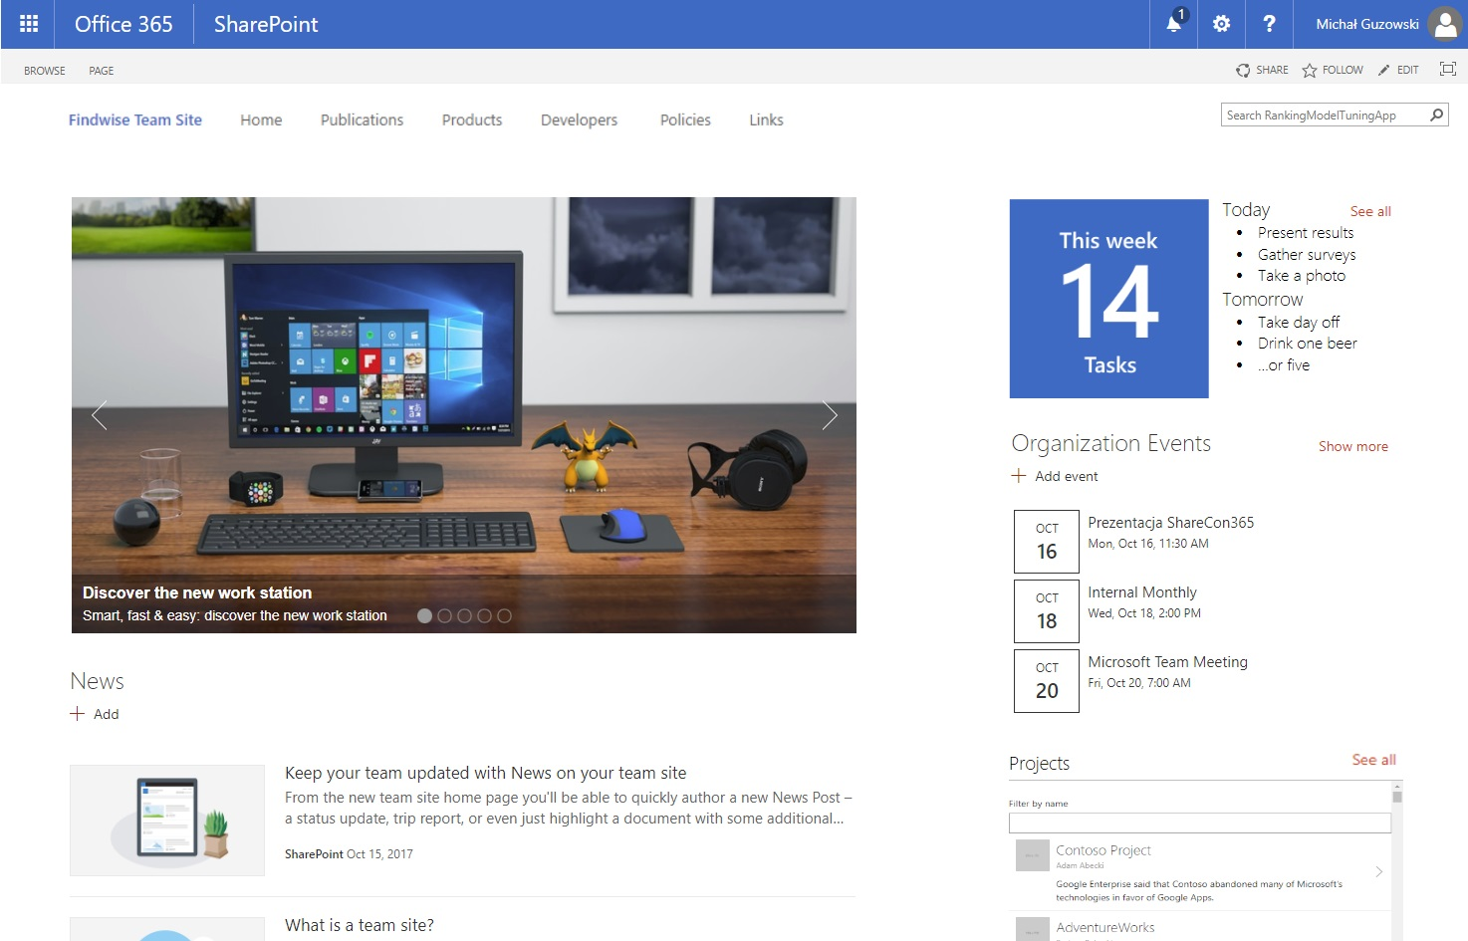
Concept

Slide 33
Conclusions
CSWP/Display Templates => SPFx?
CSWP/DT
SPFx
- HTML/JS + SP rape
- Hermetyczne
+ Search-integrated
+ React/Angular
+ Uniwersalny
+ Ulepszany

Slide 34
Conclusions
Im większy klient tym bardziej SDA
Model: crawling/content processing/indexing
Controller: Query processing (Search Schema, KQL, Result Sources)
View: SPFx
Keep It Simple Stupid
SPFx wart uwagi
Dokumentacja
Przykłady
Rozwój
Support

Slide 35
Resources
Sharepoint Search documentation - https://docs.microsoft.com/en-us/sharepoint/dev/general-development/search-in-sharepoint
Sharepoint Search - https://searchunleashed.wordpress.com
Sharepoint Search Query Tool - https://github.com/SharePoint/PnP-Tools/tree/master/Solutions/SharePoint.Search.QueryTool
SPFx Documentation - https://docs.microsoft.com/en-us/sharepoint/dev/spfx/sharepoint-framework-overview
SPFx Custom Fields - https://github.com/OlivierCC/sp-client-custom-fields
SPFx Custom Webparts - https://github.com/OlivierCC/spfx-40-fantastics
Fabric React - https://developer.microsoft.com/en-us/fabric#react
React Lifecycle - https://reactjs.org/docs/react-component.html

Slide 36

SDA + SPFx
Search Driven Architecture
SPFx
http://itgoat.pl/ankieta/ Michal.Guzowski@Findwise.com

